Slide 1


Monitoring-Oriented Programming
Seyed Mohammad Mehdi Ahmadpanah
smahmadpanah@aut.ac.ir
Supervisor
Dr. Mehran S. Fallah
Formal Security Lab.
CEIT@AUT
Mar. 5, 2017

Slide 2

Outline
Introduction and Preliminaries
Runtime Verification and Monitor
Related Work
Aspect-Oriented Programming and Design By Contract
Monitoring-Oriented Programming
Concepts
Logic Plugins
Parametric Monitoring
JavaMOP and Extensions
In Relation to Enforceable Security Policies
Examples and Demo
Conclusion and Future Work

Slide 3

What does “Monitor” mean?
(noun) a device used for observing, checking, or keeping a continuous record of something - Oxford
(noun) someone who gives a warning so that a mistake can be avoided – Concise
(verb) observe and check the progress or quality of something over a period of time; keep under systematic review - Oxford
(verb) keep an eye on - Concise

Slide 4

Why Monitoring?
Monitoring is well-adopted in many engineering disciplines
Fuses, watchdogs, fire-alarms, etc.
Monitoring adds redundancy
Increases reliability, robustness and confidence in correct behavior, reduces risk
Provably correct systems can fail, too
Unexpected environment, wrong/strong assumptions, hardware or OS errors, etc.
Notes:
Correctness Checking
Debugging and Testing
Fault Protection/Dependability
Security/Intrusion Detection/Reliability
Aspect-Oriented Programming
Program Understanding
Reliability: Consistently performs according to its specification (to function under stated conditions for a specified period of time.)
robustness is the ability of a computer system to cope with errors during execution and cope with erroneous input

Slide 5
Runtime Verification and Monitoring
Aims at achieving benefits of both testing and formal verification, avoiding their pitfalls
Question: what do we really want … ?
A. To prove a program correct?
B. To achieve correct execution?
Often “A => B”, but isn’t the price too high?
Focusing on B, one sometimes also gets A
Instead of proving systems correct, observe, check and control their execution

Slide 6
General Idea of Runtime Verification
Program(a,b,…)
Run it;
observe & check
Spec(a,b,…)
no
Correct it
(if possible)
yes

Slide 7
Specification and Programming
Specification
Dynamic Analysis
Test Input/ Schedule Generation
Static Analysis
Runtime Verification
Program
Input
Output

Slide 8
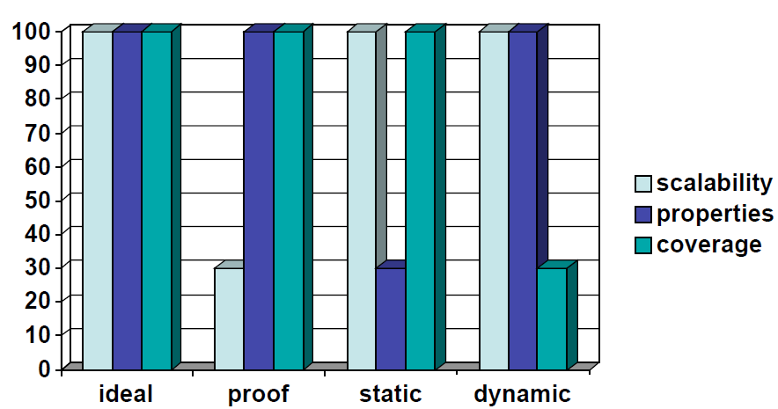
Comparison of Techniques
Giving up on coverage to write better specifications and scale

Slide 9
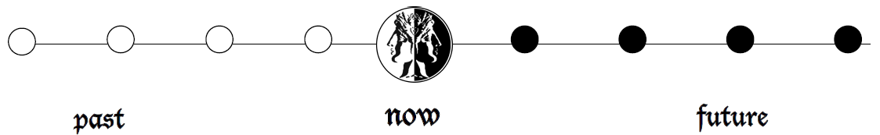
What is Trace?
A formal view of an execution is to consider it as a sequence σ of program states:
σ = s₁ s₂ s₃ … s_{n}
Past in known vs. Future is unknown

Slide 10
The Cycle
Instrumentation Language (I)
Property Specification Language (P)
Reaction Language (R)
Application
I
Monitor
P
Reaction
R

Slide 11

Property Languages
Programming Languages
Program (built-in algorithms focused on specific problem)
Data Race Detection
Atomicity Violation
Deadlock Detection
Formal Languages
Design By Contract (pre/post condition)
State Machines
Regular Expressions
Grammars e.g. Context-Free
Temporal Logic (past time, future time)
Process Algebra (CSP/CCS)
Full Fledged Formal Specification Languages e.g. Z
Graphical Languages e.g. UML

Slide 12
Monitoring Integration
Offline
Analyzing log file / trace dump
Program
Monitor

Slide 13
Monitoring Integration (Cont.)
Online
Inline
Monitoring code is embedded into the application
Online
Outline
Monitor runs in parallel with application
Synchronous (Application waits for response)
Asynchronous (Buffered communication)
Program
Monitor
Program
Monitor

Slide 14
Monitoring Integration (Cont.)
Offline
Analyzing log file / trace dump
Online
Outline
Monitor runs in parallel with application
Synchronous (Application waits for response)
Asynchronous (Buffered communication)
Inline
Monitoring code is embedded into the application

Slide 15
Violation vs. Validation
Violation
checking that the systems conforms to a property, and reporting when the property is “violated”.
Validation
Stating property in negative form: what we do not want to happen, Reporting when the bad property gets “validated”.
Or, it is a good property and we just want to log whenever something good happens.
Most systems can only do one of the two forms!

Slide 16



Example - Violation
Property:
(green yellow red)*
green red

Slide 17

Example - Validation
Property:
green red
green red
Notes:
آیا همه خط مشی ها رو میشه به سادگی نقیض کرد و ولیدیشن گذاشت مثلا؟
نه،
اول اینکه خط مشی های مثل ایمنی رو میشه با اینکه چه چیزی نباید اتفاق بیفته بیان کرد.
دلیل دیگه که هر دو تا ولید و وایولیشن رو داره اینه که ممکنه بخوایم برای حالتهای مختلف این دو، اکشن متفاوت داشته باشیم.
ضمنا مثل یه خط مشی مثل اینکه «بالاخره فلان چیز رخ بدهد» رو نمیشه خیلی راحت به نقیضش ربط داد.
Note that violation and validation are not complementary properties.
However, Violate P is not the same as Validate (Not P); for every P.
Some logics like CFG do not have negation
violate ab ≠ validate ~(ab).
– reason: observe the first ‘a’ in the trace ‘ab’.
• it validates ~(ab)
• it does not violate ab yet (and will not in this case).

Slide 18

Challenges
Code Instrumentation
Definition of Specification Languages
Creation of Efficient Monitors from Specification
Minimize Impact on Monitored System
Integrate Static and Dynamic Analysis
Controlling the Application in case of Violation/Validation

Slide 19
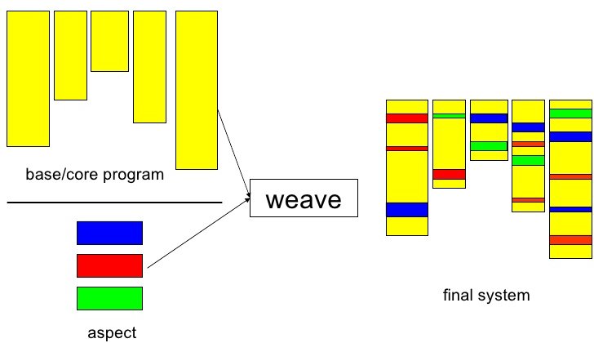
Aspect-Oriented Programming
Aims to increase modularity by allowing the separation of cross-cutting concerns.
Example: logging
Crosscut all logged classes and methods
Notes:
کلاس سگ
کلاس سگ ایرانی
ویژگی فرمانبرداربودن
ارث بری نیست!
سگ ایرانی باید از کلاس سگ ارث بری شود یا کلاس سگ فرمانبردار؟!
When thinking of an object and its relationship to other objects we often think in terms of inheritance. We define some abstract class; let us use a Dog class as an example. As we identify similar classes but with unique behaviors of their own, we often use inheritance to extend the functionality. For instance, if we identified a Poodle we could say a Poodle Is A Dog, so Poodle inherits Dog. So far so good, but what happens when we define another unique behavior later on that we label as an Obedient Dog? Surely not all Dogs are obedient, so the Dog class cannot contain the obedience behavior. Furthermore, if we were to create an Obedient Dog class that inherited from Dog, then where would a Poodle fit in that hierarchy? A Poodle is A Dog, but a Poodle may or may not be obedient; does Poodle, then, inherit from Dog, or does Poodle inherit from Obedient Dog? Instead, we can look at obedience as an aspect that we apply to any type of Dog that is obedient, as opposed to inappropriately forcing that behavior in the Dog hierarchy.
Joinpoint—Well defined points in code that can be identified.
Pointcut—A way of specifying a Joinpoint by some means of configuration or code.
Advice—A way of expressing a cross cutting action that needs to occur.

Slide 20
Aspect-Oriented Programming (cont.)
code tangling:
one module
many concerns
code scattering:
one concern
many modules
example:
logging
Notes:
logging (tracking program behavior)
verification (checking program behavior)
policy enforcement (correcting behavior)
security management (preventing attacks)
profiling (exploring where a program spends its time)
memory management
visualization of program executions

Slide 21
Aspect-Oriented Programming (cont.)
code tangling:
one module
many concerns
code scattering:
one concern
many modules
example:
logging
aspect

Slide 22

AOP Concepts
An aspect can alter the behavior of the base code (the non-aspect part of a program) by applying advice (additional behavior) at various join points (points in a program) specified in a quantification or query called a pointcut (that detects whether a given join point matches).
Notes:
Around advice can perform custom behavior before and after the method invocation.

Slide 23
Simplified View of AOP
while(more())
{
…
send(msg);
…
}
when send(msg)
{
check(msg);
}
informal
notation
weaver
program
aspect
while(more())
{
…
check(msg);
send(msg);
…
}

Slide 24
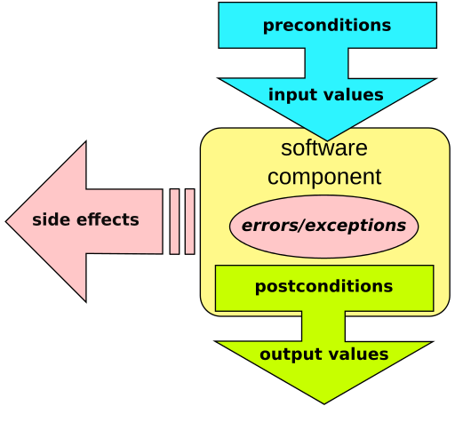
Design By Contract
Add semantic information to a program by specifying assertions regarding the program’s runtime state, and then checking the specification at runtime
Jass: A precompiler turns the assertion comments into Java code, and pre-/post- condition and class invariants
jContractor: A Java library which allows programmers to associate contracts, consisting of precondition, postcondition, and invariant, with any Java classes or interfaces
Notes:
DBC is a sample of MOP.
It prescribes that software designers should define formal, precise and verifiable interface specifications for software components, which extend the ordinary definition of abstract data types with preconditions, postconditions and invariants. These specifications are referred to as "contracts", in accordance with a conceptual metaphor with the conditions and obligations of business contracts.
What does contract expect?
What does contract guarantee?
What does contract maintain?
However, DbC considers these contracts to be so crucial to software correctness that they should be part of the design process.
The pre- and postcondition technique originated with the work of TonyHoare, whose 1969 Communications of the ACM paper described program semantics using such assertions.
Classes should specify their invariants: what is true before and after executing any public method.
Methods should specify their pre- and post-conditions: what must be true before and what must be true after their execution, respectively. Pre-conditions may be weakened by subclasses and post-conditions may be strengthened.
The explicit definition of these "assertions" forces the designer to think deeply about what is a requirement of the specification and what is an artifact of a particular implementation. These assertions can and should influence the declaration of "throws" exceptions as well as the throwing of runtime exceptions and try/catch in general.

Slide 25
What is Monitoring-Oriented Programming?
Framework for reliable software development
Monitoring is basic design discipline
Recovery allowed and encouraged
Provides to programmers and hides under the hood a large body of formal methods knowledge/techniques
Generic for different languages and application domains
Language- and Logic-independent

Slide 26
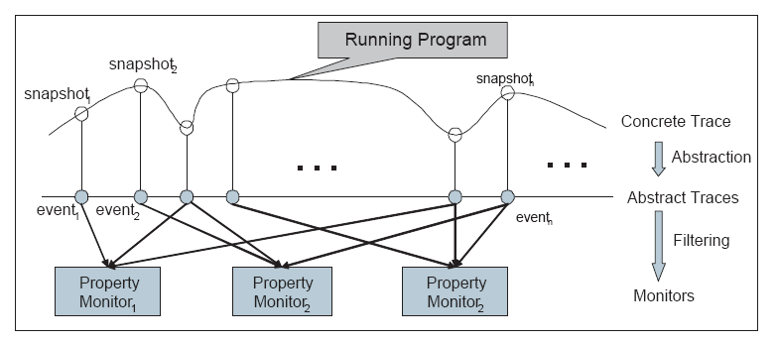
MOP Approach to Monitoring

Slide 27
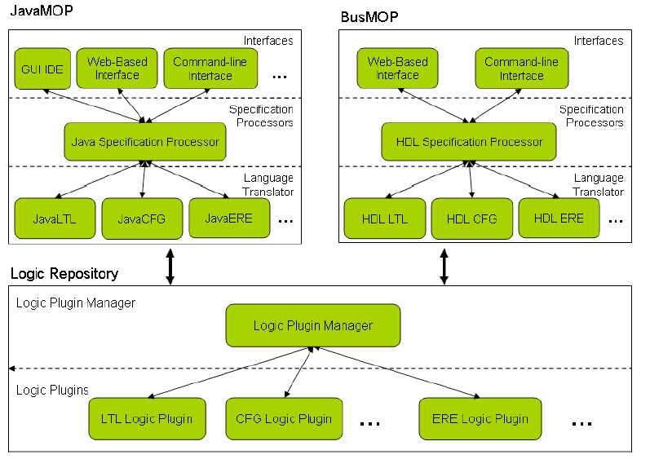
MOP Architecture
Notes:
Client-Server

Slide 28
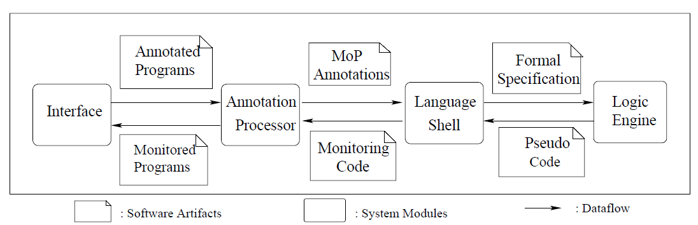
Program Transformation Flow in MOP

Slide 29

MOP
One can understand MOP from at least three perspectives:
Improving reliability of a system by monitoring its requirements against its implementation at runtime. By generating and integrating the monitors automatically rather than manually
An extension of programming languages with logics
A lightweight formal method
by not letting it go wrong at runtime
Notes:
As a discipline allowing one to improve reliability of a system by monitoring its requirements against its implementation at runtime. By generating and integrating the monitors automatically rather than manually
As an extension of programming languages with logics. One can add logical statements anywhere in the program, referring to past or future states
As a lightweight formal method. While firmly based on logical formalisms and mathematical techniques, MOP aims at avoiding verifying an implementation against its specification before operation, by not letting it go wrong at runtime

Slide 30
MOP (cont.)
Same idea as design by contract: specifications are written as comments in code. Monitors are generated from specs
Philosophy: no silver-bullet logic for specs
MOP logic plugins (a subset):
ERE (Extended Regular Expressions)
CFG (Context-Free Grammars)
PtLTL (Past-time LTL) and FtLTL (Future-time LTL)
JML (fragment of Java Modeling Language)
ATL (Allen Temporal Logic)
Jass (The CSP Process algebra)
Generic wrt. parameters
Provide a plugin for a propositional logic, and MOP does the rest wrt. data parameterization
Makes designing a new logic extremely easy compared to other frameworks

Slide 31
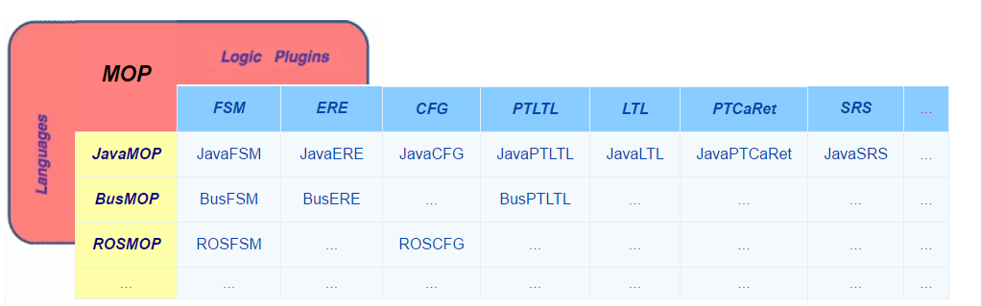
Instances of MOP
MOP generic in both specification formalisms (logics) and programming languages
MOP
JavaMOP
BusMOP
ROSMOP
…

Slide 32
Examples of Runtime Verification Systems
Approach | Language | Logic | Scope | Mode | Handler
Hawk | Java | Eagle | global | inline | violation
J-Lo | Java | ParamLTL | global | inline | violation
Jass | Java | Assertions | global | inline | violation
JavaMaC | Java | PastLTL | class | outline | violation
jContractor | Java | Contracts | global | inline | violation
JML | Java | Contracts | global | inline | violation
JPaX | Java | LTL | class | offline | violation
P2V | C/C++ | PSL | global | inline | violation/validation
PQL | Java | PQL | global | inline | validation
PTQL | Java | SQL | global | outline | validation
Spec# | C# | Contracts | global | inline/offline | violation
RuleR | Java | RuleR | global | inline | violation
Temporal Rover | Several | MiTL | class | inline | violation
Tracematches | Java | Reg. Ex. | global | inline | validation

Slide 33
How does MOP work?
Observe a run of a system
Requires instrumentation
Can be offline or online
Check it against desired properties
Specified using patterns or in a logical formalism
React/Report (if needed)
Error messages
Recovery mechanisms
General code

Slide 34
MOP Monitoring Model
Program Execution
Observation/Abstraction
Action
Abstract Trace
Verification
…
Monitors
M₁
M₂
M₃
Action
Monitors verify abstract traces against desired properties;
can be dynamically created or destroyed

Slide 35
MOP: Extensible Logic Framework
Can we generate monitors automatically from specifications?
Generic in specification formalisms
Logic Plugin: monitor synthesis components for different logics as plugins
Current Plugins
FSM, ERE, PTLTL, FTLTL, ATL, JML, PtCaRet, CFG,…
Also, Raw specifications are allowed
Notes:
FSM (Finite State Machine), ERE (extended regular expressions), PTLTL (Past-time LTL), FTLTL (Future-time LTL), ATL (Allen temporal logic), JML (Java modeling language), PtCaRet (Past-time Call/Return), CFG (Context-free grammars), …

Slide 36
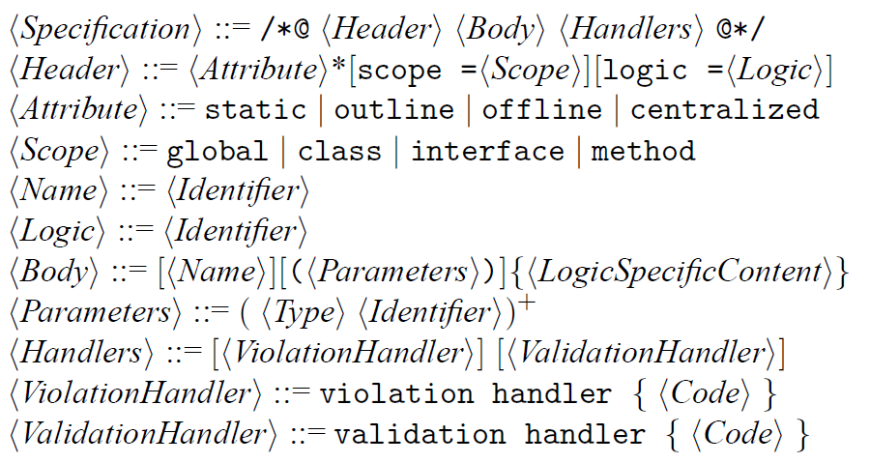
MOP Syntax

Slide 37
MOP Example: Safe Enumeration
/*@
scope = global
logic = ERE
SafeEnum (Vector v, Enumeration+ e) {
[String location = "";]
event create<v,e>: end(call(Enumeration+.new(v,..))) with (e);
event updatesource<v>: end(call(* v.add*(..))) \/
end(call(* v.remove*(..))) \/ ...
{location = @LOC;}
event next<e>: begin(call(* e.nextElement()));
formula : create next* updatesource+ next
}
validation handler { System.out.println("Vector updated at "
+ @MONITOR.location); }
@*/
Notes:
>250 LOC AspectJ
Fail-fast → Iterator → Throws ConcurrentModificationException Exception by modifying the object while traversing
Fail-safe → Enumeration → Not throwing exception, because it works on a clone of objects, not the actual ones.
http://javaconceptoftheday.com/fail-fast-and-fail-safe-iterators-in-java-with-examples/

Slide 38
FSM Plugin (Finite State Machine)
Easy to use, yet powerful
Many approaches/users encode important properties directly in finite state machines
Monitoring FSM
Direct translation from an FSM specification to a monitor
Regular Expression (RE)
Deterministic Finite State Automaton (DFA)
Monitor (M)

Slide 39
FSM Plugin - Example
File Access Property
(open (read* + write*) close)*
fsm:
!s0[
open -> s1
]
s1[
read -> s3
write -> s2
close -> s0
]
s2[
write -> s2
close -> s0
]
s3[
read -> s3
close -> s0
]

Slide 40
ERE Plugin (Extended Regular Expressions)
Regular expressions
Widely used in programming, easy to master for ordinary programmers
Existing monitor synthesis algorithm
Extended regular expressions
Extend regular expressions with complement (negation)
Specify properties non-elementarily more compactly
More complicated to monitor

Slide 41
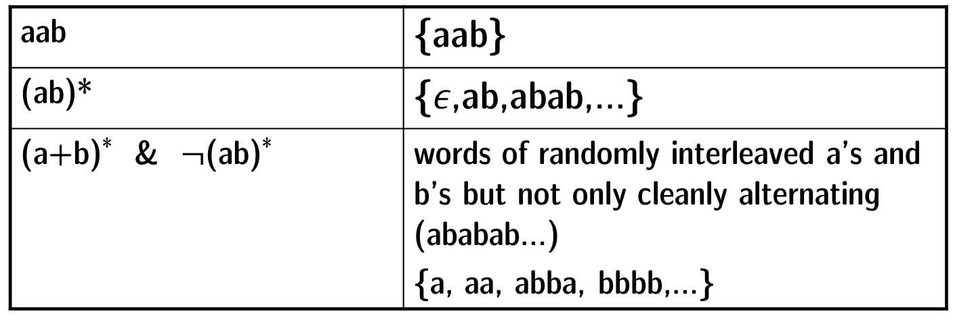
Syntax for ERE
E ::= $∅$ | $ε$ | A | E E | E* | E+E | E&E | $¬$E
extended with negation
Example - A = {a,b,c}:
aab | {aab}
(ab)* | {$ε$,ab,abab,…}
(a+b)* & $¬$(ab)* | words of randomly interleaved a’s and b’s but not only cleanly alternating (ababab…) {a, aa, abba, bbbb,…}

Slide 42
Limitations of Regular Expressions for Specification
Convenient for brief properties
Less convenient on very state-full problems, where all good or bad behaviors must be formulated
Can only express regular properties, cannot count an apriori unknown number of times, e.g. lock-release property

Slide 43
LTL Plugin (Linear Temporal Logic)
MOP includes both a past-time plugin (PTLTL) and a future-time plugin (FTLTL) for LTL
PTLTL uses a dynamic programming algorithm, low resources, suitable for hardware
FTLTL uses a transformed/optimized Buchi automata construction, but still may generate large monitors that cannot be stored

Slide 44

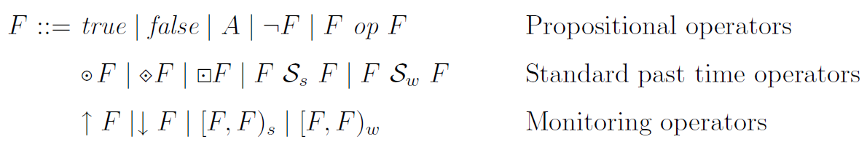
Syntax for LTL
PastLTL
Example: one cannot dial when the phone is busy or connected
previous eventually always since
start end F butnot F’
Notes:
Paper No. 1 (Page 8)
op, are the standard ones, that is, disjunction,
conjunction, implication, equivalence, and exclusive disjunction
The operator ◦・ F
should be read “previously F”; its intuition is that F held at the immediately
previous step of execution. ・ F should be read “eventually in the past F”,
with the intuition that there is some past moment in time when F was true.
・ F should be read “always in the past F”, with the obvious meaning. The
operator F1 Ss F2, which should be read “F1 strong since F2”, reflects the
intuition that F2 held at some moment in the past and, since then, F1 held
all the time. F1 Sw F2 is a weak version of “since”, read “F1 weak since F2”,
saying that either F1 was true all the time or otherwise F1 Ss F2.

Slide 45
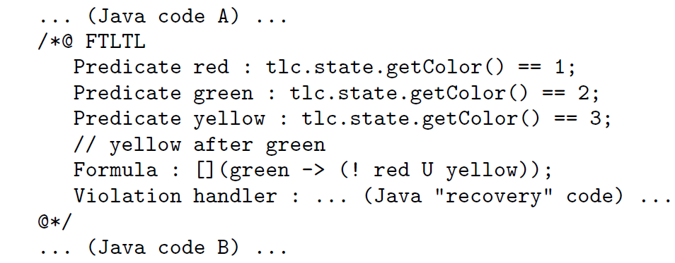
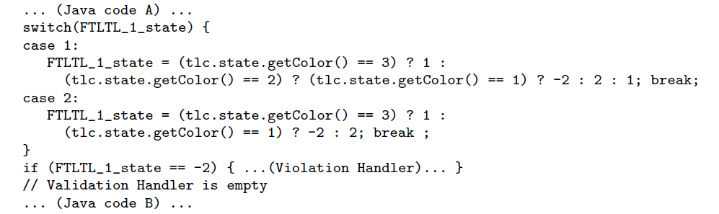
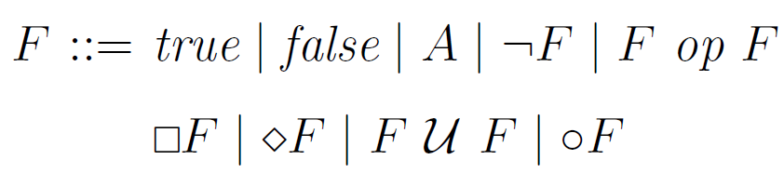

Syntax for LTL
FutureLTL
Example: after green yellow comes
always eventually until next
Notes:
Paper No. 1 (Page 8)
op, are the standard ones, that is, disjunction,
conjunction, implication, equivalence, and exclusive disjunction
The formula X holds if X holds in all time points, while
X holds if X holds in some future time point. The formula X U Y (X until
Y ) holds if Y holds in some future time point, and until then X holds (so we
consider strict until). Finally, ◦X holds for a trace if X holds in the suffix
trace starting in the next (the second) time point. The propositional operators
have their obvious meaning.

Slide 46

The Language Hierarchy
S -> $ε$ | aSb
a
Context-Free
1
2
Regular
true
Temporal
a /\ [](a -> o b) /\ [](b -> o a)
Notes:
structured properties that refer to the call stack of the program.
Structured properties: Those that take the call stack into account, basically anything that is looking for more than a flat trace.
This property insures that the releases and acquires of locks are balanced
structured properties, referring to
the structure of the program. Examples of such structured
safety properties include “a resource should be released in
the same method which acquired it” or “a resource cannot
be accessed if the unsafe method foo is in the current call
stack”.

Slide 47
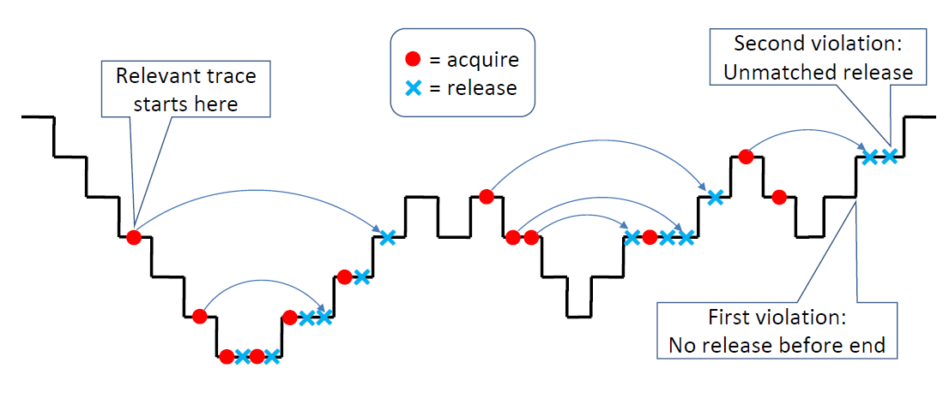
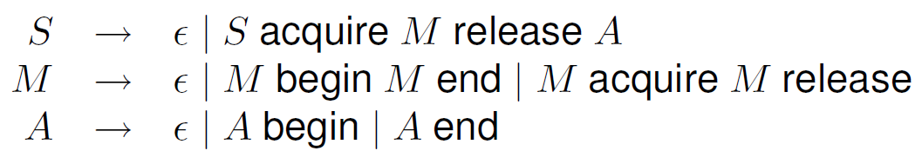


CFG Plugin (Context-Free Grammar)
Most systems support finite state monitors
Regular languages
Linear temporal logics
These cannot monitor structured properties:
Notes:
structured properties that refer to the call stack of the program.
Structured properties: Those that take the call stack into account, basically anything that is looking for more than a flat trace.
This property insures that the releases and acquires of locks are balanced
structured properties, referring to
the structure of the program. Examples of such structured
safety properties include “a resource should be released in
the same method which acquired it” or “a resource cannot
be accessed if the unsafe method foo is in the current call
stack”.

Slide 48
Recall – MOP Monitoring Model
Program Execution
Observation/Abstraction
Action
Abstract Trace
Verification
…
Monitors
M₁
M₂
M₃
Action
Monitors can be dynamically created or destroyed – why?
Parametric Monitoring

Slide 49
Parametric Properties
Imperatively needed, but hard to monitor efficiently
Parameters
SafeEnum(Vector v, Enumeration+ e) {
event create after(Vector v) returning(Enumeration e): ...
event updatesource after(Vector v) : ...
event next before(Enumeration e) : ...
ere : create next* updatesource updatesource* next
@match { System.out.println(“Failed Enumeration!"); }
}
Notes:
To have monitors on each Object
Lack of parameters leads to false alarms:
The first challenge originally came from object-oriented programs. We have seen that we can detect the error in this execution; but what if the task thread changes a different vector v2? In such case, there is no violation of the property. But we may have the same execution trace and it causes a warning, which is obviously a false alarm. The problem is clear: this trace is too abstract and cannot tell the difference between the two programs. So we need to add more information to the trace; but that brings new challenges about analyzing the trace, as I will discuss in a couple slides.

Slide 50
Lack of Parameters Leads to False Alarms
…
Main Thread:
Vector v = //initialization;
…
Enumeration e = v.elements();
…
Object obj = e.nextElement();
…
Task Thread:
…
v.remove(0);
…
create
updatesource
v2.remove(0);
next
Appear to be a violation but it is not; false alarm!
Notes:
The first challenge originally came from object-oriented programs. We have seen that we can detect the error in this execution; but what if the task thread changes a different vector v2? In such case, there is no violation of the property. But we may have the same execution trace and it causes a warning, which is obviously a false alarm. The problem is clear: this trace is too abstract and cannot tell the difference between the two programs. So we need to add more information to the trace; but that brings new challenges about analyzing the trace, as I will discuss in a couple slides.

Slide 51
Adding Parameters to Events
…
Parametric traces: traces containing events with parameters
Main Thread:
Vector v = //initialization;
…
Enumeration e = v.elements();
…
Object obj = e.nextElement();
…
Task Thread:
…
v2.remove(0);
…
create(v, e)
update(v)
update(v2)
v.remove(0);
next(e)
…
Notes:
abundant in practice, especially in object-oriented programs

Slide 52
Checking Parametric Traces
parametric trace
parametric monitor
updatesource(v1)
non-parametric monitor
create (v1,e1)
next
0
create
1
updatesource(v2)
next(e1)
updatesource
next
2
create(v1,e2)
3
updatesource(v1)
updatesource
next(e1)

Slide 53
Parametric Trace Slicing
v1, e1
v1, e2
v2, e1
v2, e2
update(v1)
updatesource
updatesource
updatesource(v1)
create (v1,e1)
create
create (v1,e1)
updatesource(v2)
trace slice
updatesource
next(e1)
next
next
next(e1)
create(v1,e2)
create
updatesource(v1)
updatesource
updatesource(v1)
next(e1)
next
next
next(e1)
For given parameters (v, e)

Slide 54
Monitoring of Parametric Traces
Naïve Monitoring
Every parametric trace contains multiple non-parametric trace slices, each corresponding to a particular parameter binding
NOT Efficient
Online Parametric Trace Slicing
Process events as receiving them and do not look back for the previous events
Efficient
Scan the trace once
Events discarded immediately after being processed
What information should be kept for the unknown future?
Notes:
By online, we mean that the trace arrives incrementally, one event at a time
But this solution is not efficient enough in many cases: the trace can be very long, for example, in some our experiments, the observed executions contained millions of events.

Slide 55
Online Parametric Trace Slicing - Example
v1
v1, e1
v2
e1
v2, e1
v1, e2
update
update
update(v1)
update
Optimization: based on static property analysis, generate
specialized slicing code for the given specification
createEnum(v1,e1)
createEnum
update(v2)
update
update
useEnum(e1)
useEnum
useEnum
useEnum
createEnum(v1,e2)
createEnum
For given parameters (v, e)

Slide 56
JavaMOP
Layered architecture for extensibility
Supports most logics provided by the MOP framework e.g. FSM, ERE, PTLTL, FTLTL, PTCaRet, and CFG
Efficient support for generic universal parameters
Supports both centralized and decentralized indexing for better flexibility in practice
AspectJ based specification syntax
Generates AspectJ code from JavaMOP specifications
Use any off-the-shelf AspectJ compiler to weave the monitoring code into the target program
Overhead <10% in most cases; close to hand-optimized More expressivity and less overhead in comparison with other tools
Notes:
Make use of different techniques and languages
Program generation, term rewriting, aspect-oriented programming,…

Slide 57
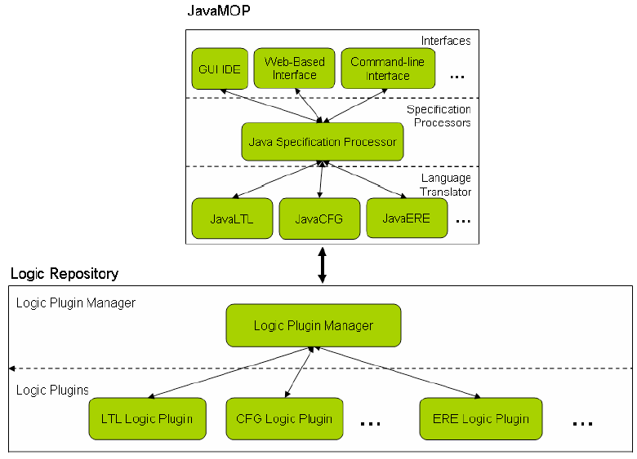
JavaMOP Architecture
Notes:
Specification Syntax
Examples on Demo
Run JavaMOP Online!
BusMOP: VHDL event extraction code and Verilog based monitors
ZERO Runtime overhead

Slide 58

Evolution-Aware MOP
Extend MOP to support multiple software versions
The key idea:
To monitor only the parts of code that changed between versions
inspired by Regression Test Selection (RST)
Improving efficiency and usability
Regression Property Selection (RPS) and Regression Monitor Selection (RMS)
Notes:
RST (regression test selection)
Improving efficiency of regression testing by selecting to re-run only a subset of tests that may be affected [22] by code changes between two versions.
The goal of RPS is to re-monitor only properties that can be
affected by the code changes.
The key idea is to map each property to all the parts of the
code from which events were sent to monitors initiated from
that property.
RMS prevents monitors from being regenerated for code that
cannot be affected by the changes, even if the related property
is affected by the change
for making MOP evolution-aware and more practical
eMOP can reduce the runtime overhead for monitoring evolving software versions and can show developers only the property violations
based on the most recent code changes.

Slide 59
JavaMOP and Security Policies
Inlined Reference Monitor (IRM) vs. Runtime Verification
Security specification vs. System specification
The usage of JavaMOP as an IRM system to specify and enforce security policies
Highly expressive and More efficient
e.g. Chineese Wall in JavaMOP using CFG
Should not be used for low-level security policies
Notes:
JavaMOP is designed to be a general RV
system that can be used for many purposes, not necessarily for
security.
IRM can be considered
as a specific instance of RV.
Examples:
The Chinese Wall Policy in JavaMOP using Context Free Grammar (cfg)
Access Control
Separation of Duties
SQL Injection
File Network Wall
…
JavaMOP should
not be used, for example, to specify and enforce low level security
policies like memory management and software fault tolerance
isolation.

Slide 60
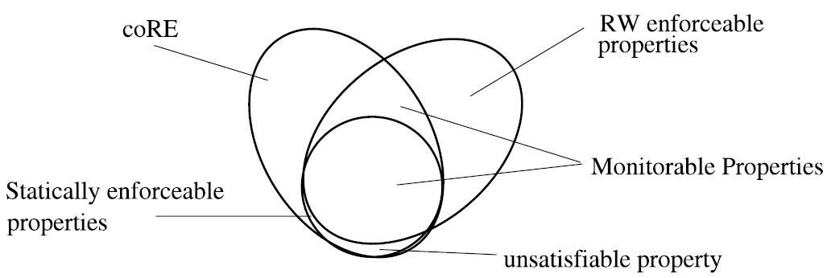
JavaMOP and Security Policies (cont.)
It monitors a single execution trace as it occurs
Cannot monitor nonproperties (e.g. Information Flow Policies)
Can enforce properties
Liveness properties cannot be expressed by any monitor
By bounding to a limit, they became safety policies
JavaMOP with AspectJ is able to rewrite the target program
A Program Rewriter
Can enforce RW-enforceable policies
Including EM-Policies and Satisfiable static policies
Notes:
Policies that check that no principal ever has access to a given
resource are liveness properties, thus they cannot be expressed
by any monitoring system because any partial execution may be
extended to a invalid one. However if the availability is bounded
to a limit then it can be expressed, e.g., a policy which monitors
denials bounded within a set period of seconds
And since JavaMOP (with AspectJ) is able to rewrite the target
to enforce security policies and to trigger possibly different corrective
handlers upon violation of a policy, JavaMOP is categorized
as a Program Rewrite [21]. And thus JavaMOP can enforce RWenforceable
policies (policies that are enforceable by rewriting the
program to an equivalent valid execution) including EM-policies
(Execution Monitor policies) and satisfiable static policies [21].

Slide 61

Conclusion
MOP a generic yet efficient runtime verification framework
Extensible logic framework: FSM, ERE, PTLTL, FTLTL, LTL, CFG, PTCaRet, …
Adaptable for different programming languages
JavaMOP, BusMOP, …
Notes:
PTCaRet extends the past time linear temporal logic (PTLTL) with call/return atoms.

Slide 62
Future Work
There is room for richer/better RV systems
More suitable logics for specifications
More programming languages/platforms
System level monitoring
JavaMOP: using RV as a crosscutting configurable feature of runtime execution environments for "configurable Java".
Combining RV with specification mining
Combining RV and static program verification

Slide 63
References
Monitoring-Oriented Programming (MOP) official website: http://fsl.cs.uiuc.edu/mop
Some slides from http://www.runtime-verification.org/course/ (9 lectures)
[1] F. Chen and G. Roşu, “Towards monitoring-oriented programming: A paradigm combining specification and implementation,” in Electronic Notes in Theoretical Computer Science, 2003, vol. 89, no. 2, pp. 113–132.
[2] F. Chen, D. Jin, P. Meredith, and G. Roşu, “Monitoring Oriented Programming - A Project Overview,” in Proceedings of the Fourth International Conference on Intelligent Computing and Information Systems (ICICIS’09), 2009, pp. 72–77.
[3] F. Chen and G. Roşu, “Java-MOP: A Monitoring Oriented Programming Environment for Java,” in Tools and Algorithms for the Construction and Analysis of Systems: 11th International Conference, TACAS 2005, Heidelberg: Springer Berlin Heidelberg, 2005, pp. 546–550.
[4] F. Chen, M. D’Amorim, and G. Roşu, “A Formal Monitoring-Based Framework for Software Development and Analysis,” in Formal Methods and Software Engineering: 6th International Conference on Formal Engineering Methods, ICFEM 2004, Seattle, WA, USA, November 8-12, 2004. Proceedings, Heidelberg: Springer Berlin Heidelberg, 2004, pp. 357–372.
[5] F. Chen and G. Roşu, “Mop: an efficient and generic runtime verification framework,” ACM SIGPLAN Not., no. 448501, pp. 569–588, 2007.

Slide 64
References (cont.)
[6] P. O. N. Meredith, D. Jin, D. Griffith, F. Chen, and G. Roşu, “An overview of the MOP runtime verification framework,” Int. J. Softw. Tools Technol. Transf., vol. 14, no. 3, pp. 249–289, 2012.
[7] O. Legunsen, D. Marinov, and G. Roşu, “Evolution-Aware Monitoring-Oriented Programming,” in Proceedings - International Conference on Software Engineering, 2015, vol. 2, pp. 615–618.
[8] D. Jin, P. O. N. Meredith, C. Lee, and G. Roşu, “JavaMOP: Efficient parametric runtime monitoring framework,” in Proceedings - International Conference on Software Engineering, 2012, pp. 1427–1430.
[9] S. Hussein, P. Meredith, and G. Roşu, “Security-policy monitoring and enforcement with JavaMOP,” PLAS ’12 Proc. 7th Work. Program. Lang. Anal. Secur., pp. 1–11, 2012.
[10] P. O. N. Meredith, D. Jin, F. Chen, and G. Roşu, “Efficient monitoring of parametric context-free patterns,” in Automated Software Engineering, 2010, vol. 17, no. 2, pp. 149–180.
[11] F. Chen, M. d’Amorim, and G. Roşu, “Checking and Correcting Behaviors of Java Programs at Runtime with Java-MOP,” Electron. Notes Theor. Comput. Sci., vol. 144, no. 4 SPEC. ISS., pp. 3–20, 2006.

Slide 65

A Tragedy – Feng Chen
Due to a sudden vascular accident and complications from an undetected blood clot, Feng Chen passed away on August 8, 2009
Ph.D. : Defended in July 2009
After his graduation, Feng had accepted a tenure-track position at Iowa State University
He has three papers AFTER his death!
Tributes from Rosu, Meseguer, Pnueli, and …
In Memoriam
Live the moment NOW! ☺
Notes:
Feng has not only been my first and dear student, but in time he has become an invaluable colleague and eventually a very good friend, one whose opinion I always asked when important decisions had to be taken in our group.
Many Awards!
http://fsl.cs.uiuc.edu/index.php/Feng_Chen

Slide 66

Any Questions?

